Slide 1
Investigation of High-Capacity Digital Coherent Transceivers
Aimilios Christou, G&C College, ac2146

Slide 2
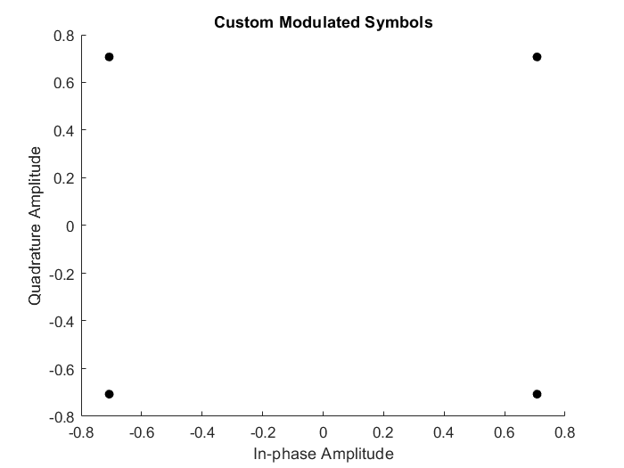
Modeling the transmitter
Began by sending a collection of 10000 random symbols
Modulation with gray-mapped QPSK (Matlab function)
Adding random noise in amplitude and phase
Implementation of my own QPSK function to better understand the concept
Demodulation with Matlab-provided functions
Wk 1

Slide 3
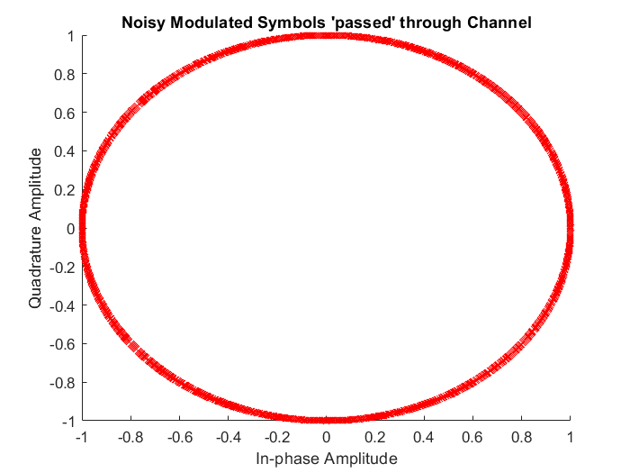
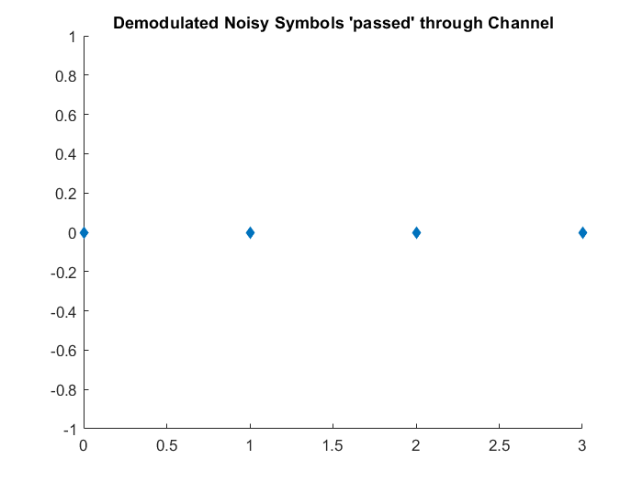
Noise and Demodulation

Slide 4
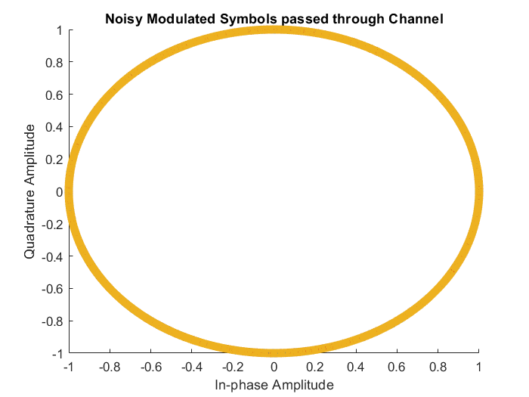
Random Walk Noise and Noise Sets
Created different sets of noise
Each set is an order of magnitude larger than the previous one
This noise only affects phase
The cumulative sum function was used to model the phase noise as a random walk process
Wk 2

Slide 5
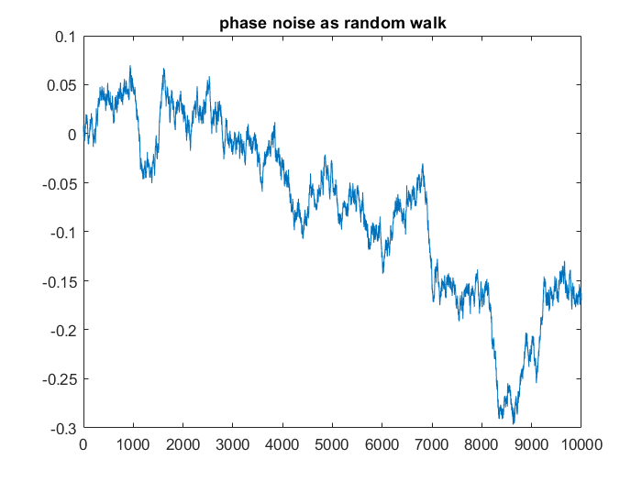
Random Walk Noise and Noise Sets

Slide 6
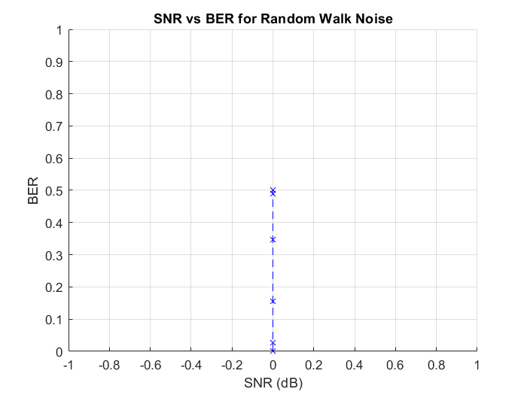
SNR and BER for Random Walk Noise
Plotting noise in a wrong way, bugs in code that need to be fixed
Attempting to measure noise with the snr Matlab function, cannot find the ratio between noisy signal and unfiltered signal correctly
Cannot find snr between symbols vector and their added phase noise vector either, approach replaced with specifying SNR directly instead of measuring it
Wk 3

Slide 7
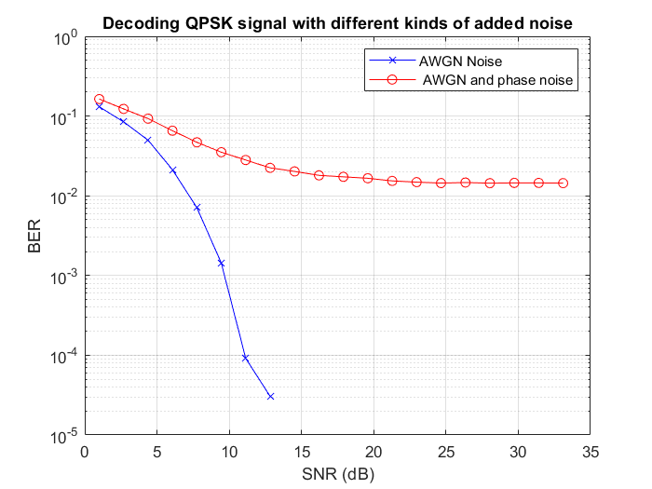
SNR and BER with AWGN
Repeating the transmission with AWGN noise gives the expected result.
Now two different noise models can be compared in further experiments
Created a known-symbol set instead of a random one for more control over the input

Slide 8
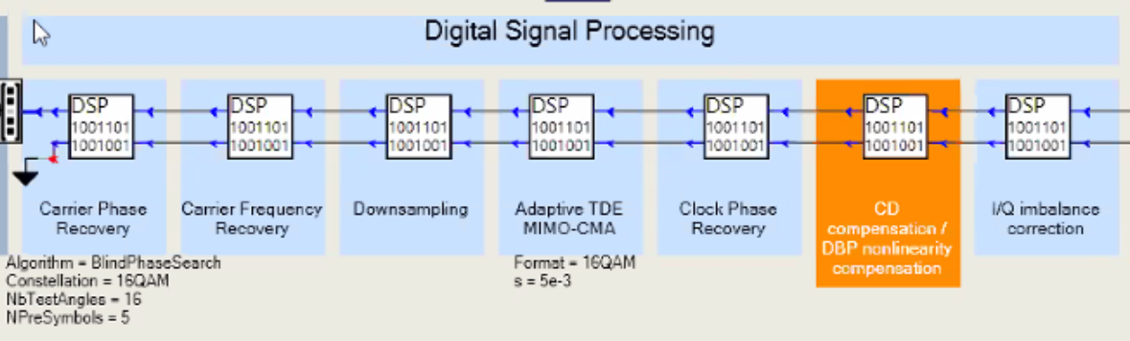
Working towards a transceiver model
Wk 4

Slide 9
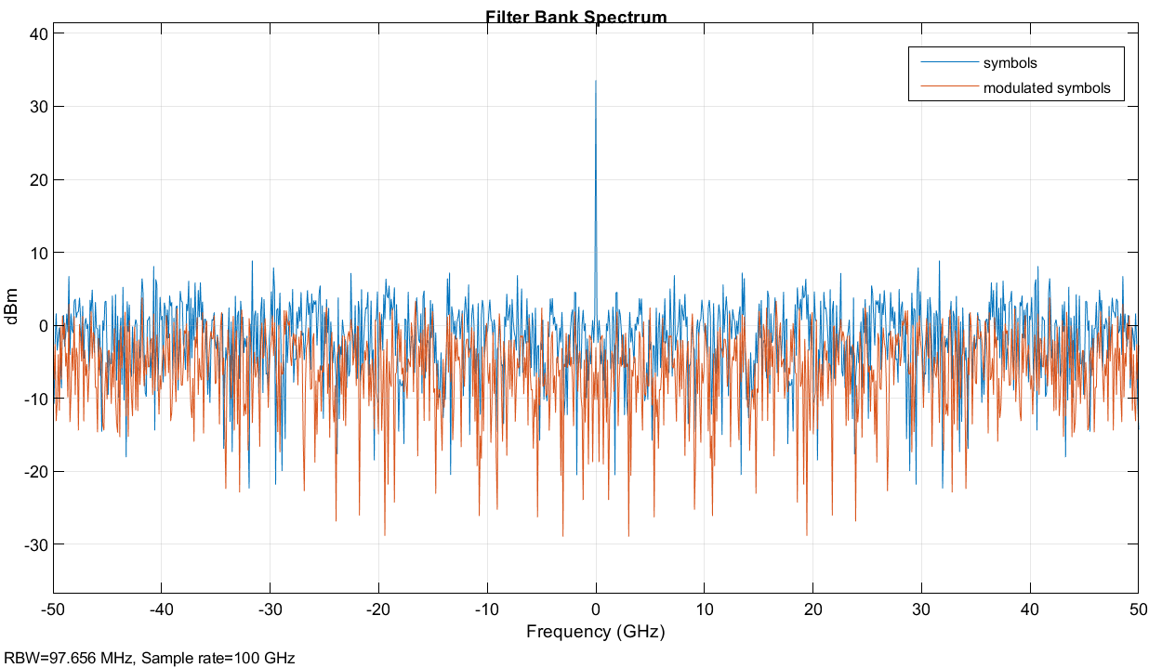
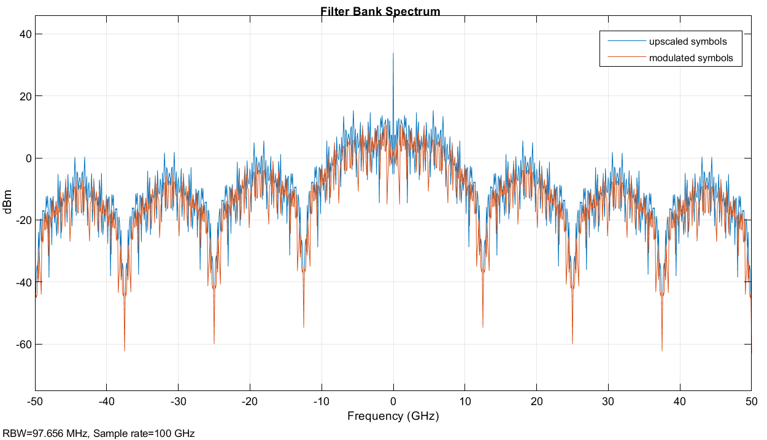
Upscaling and FFT
Upscaled the symbols by 8, plotted the spectrum before and after modulation
Compared the spectrum with the spectrum of the symbols without upscaling
Learning about the Filter Bank method for spectrum plotting
Wk 5

Slide 10
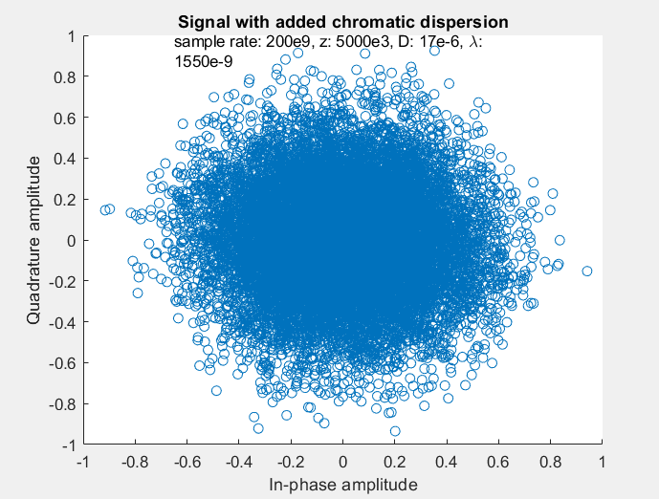
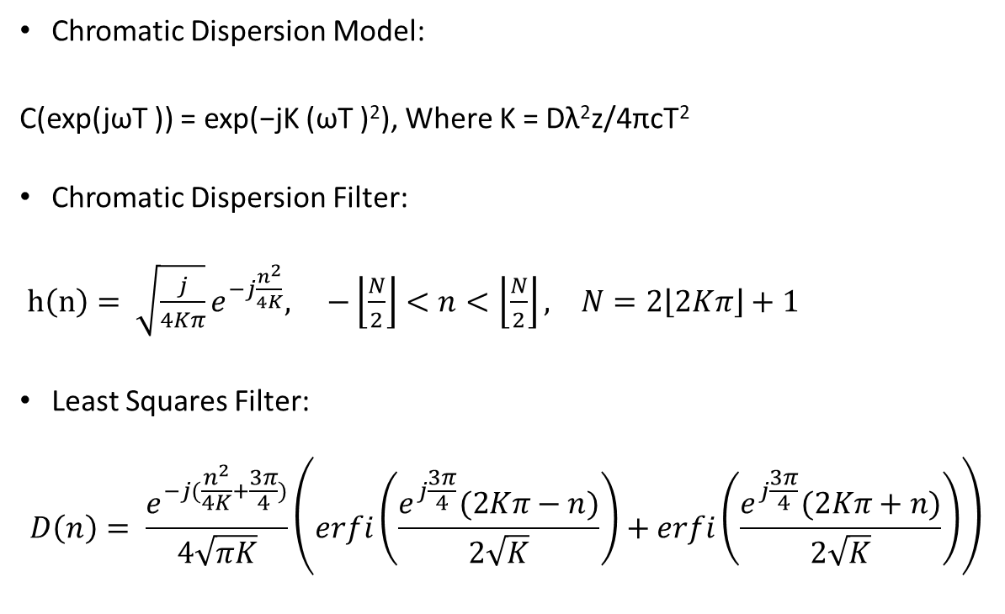
Chromatic Dispersion
Chromatic Dispersion Model:
C(exp(jωT )) = exp(−jK (ωT )²), Where K = Dλ²z/4πcT²
Chromatic Dispersion Filter:
$h\left(n\right)= \sqrt{\frac{j}{4Kπ}}e^{−j\frac{n^{2}}{4K}}, −\left\lfloor \frac{N}{2}\right\rfloor <n<\left\lfloor \frac{N}{2}\right\rfloor , N=2\left\lfloor 2Kπ\right\rfloor +1$
Least Squares Filter:
$$D\left(n\right)= \frac{e^{−j(\frac{n^{2}}{4K}+\frac{3π}{4})}}{4\sqrt{πK}}\left(erfi\left(\frac{e^{j\frac{3π}{4}}(2Kπ−n)}{2\sqrt{K}}\right)+erfi\left(\frac{e^{j\frac{3π}{4}}(2Kπ+n)}{2\sqrt{K}}\right)\right)$$
Unable to implement ω as a vector correctly, do not know how to get the taps for an impulse response for the CD Model
Wk 6&7

Slide 11
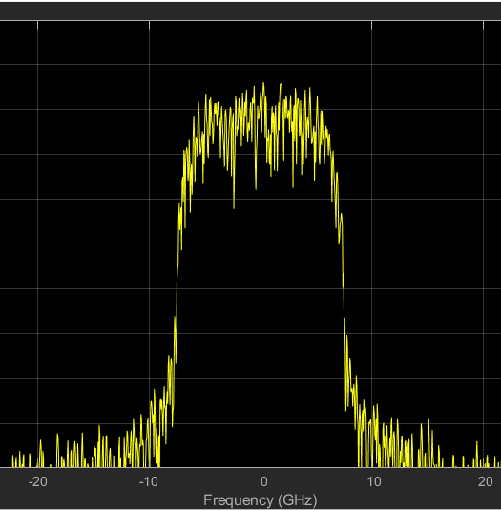
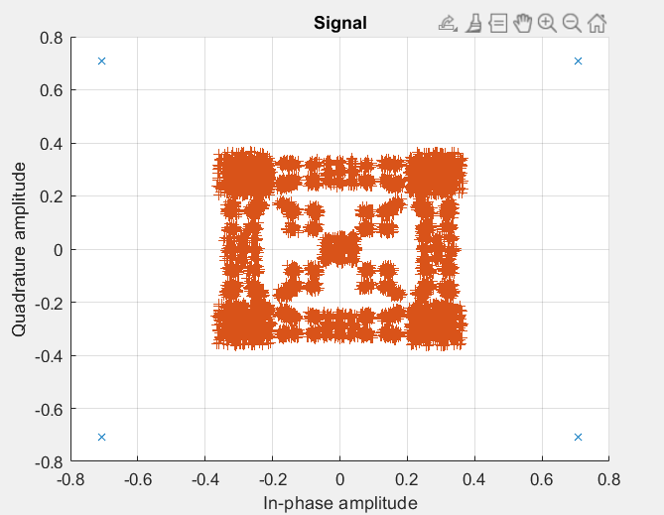
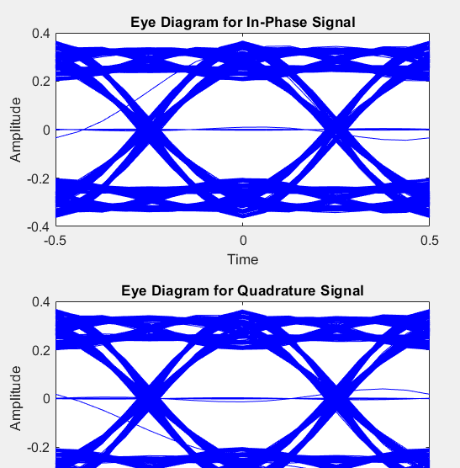
Pulse Shaping
Raised Cosine Filter with Interpolation/Decimation
Filter Parameters: Square Root, Roll off = 0.5, Taps: 32, Upsampling: 8
(looked at other filters: Nyquist)
Wk 8

Slide 12
Need to Account for Delay in pulse-shaping filters
Delay is equal to N//2 where N is the number of taps used for a filter
> Using two filters (tx and rx) leads to a total delay of N taps
Therefore, need to shift output by N taps before demodulation

Slide 13
Diagram of Current Process
Create an array of 32K random symbols
Modulate with QPSK, with initial phase π/4 and gray coding
Filter with a pulse shaping filter¹
Add AWGN
Add phase noise
Automatic gain control for normalization
Match filtering with a pulse shaping filter¹
Demodulate from QPSK
Estimate BER, SNR and plot spectra
¹Filter Parameters:
Upsampling/Downscaling = 8
Rolloff = 0.2
Tap Length = 32
Shape: Root Raised Cosine

Slide 14
Diagram of Expanded Process
Create an array of 32K random symbols
Modulate:
QPSK, 16QAM, 64QAM
QPSK: initial phase π/4 , gray coding
Filter with a pulse shaping filter¹
Add AWGN
Add phase noise
Automatic gain control for normalization
Match filtering with a pulse shaping filter¹
Demodulate from QPSK, 16QAM, 64QAM
Estimate BER, SNR and plot spectra
Add Chromatic Dispersion
Resolve Chromatic Dispersion
Frequency Equalisation
Carrier Equalisation
FEC Encoding/Preamble
Decode using FEC
¹Filter Parameters:
Upsampling/Downscaling = 8
Rolloff = 0.2
Tap Length = 32
Shape: Root Raised Cosine

Slide 15
Things to be integrated after individual testing
Filter Delay
16QAM
64QAM
Chromatic Dispersion implementation and DSP filters to account for it
FEC
Carrier Equalisation
Frequency Equalisation

Slide 16
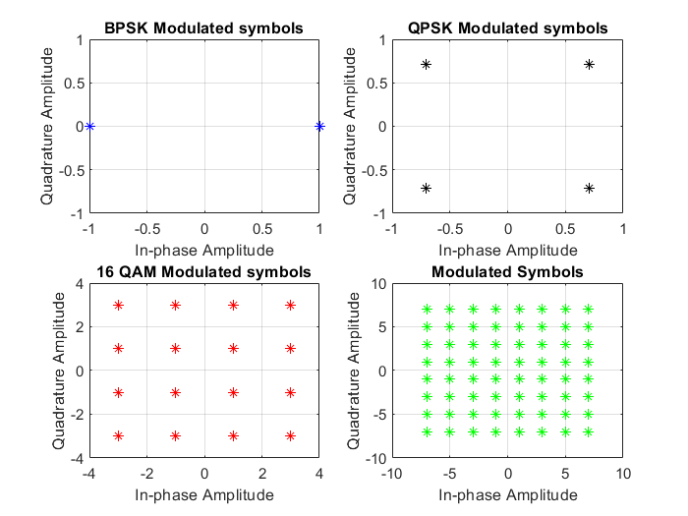
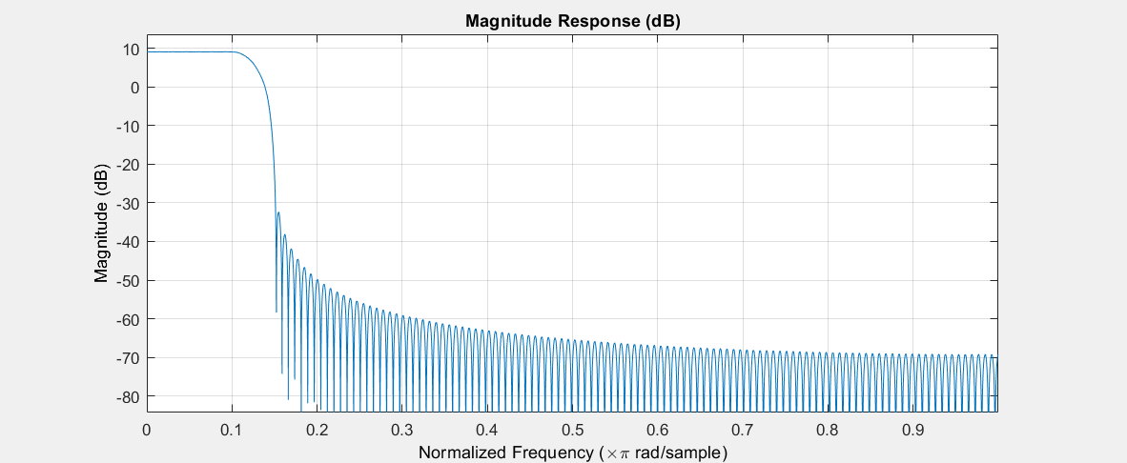
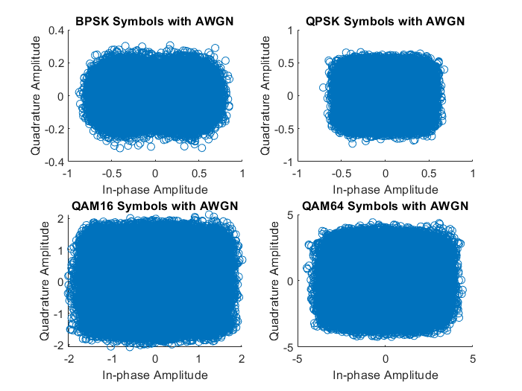
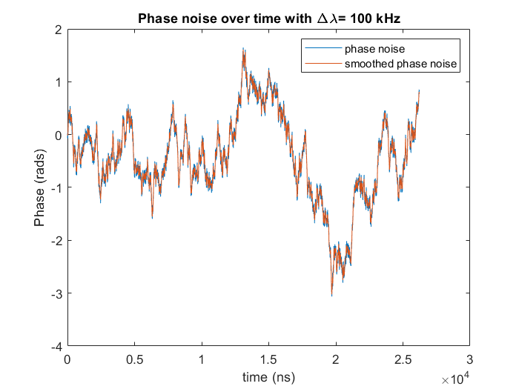
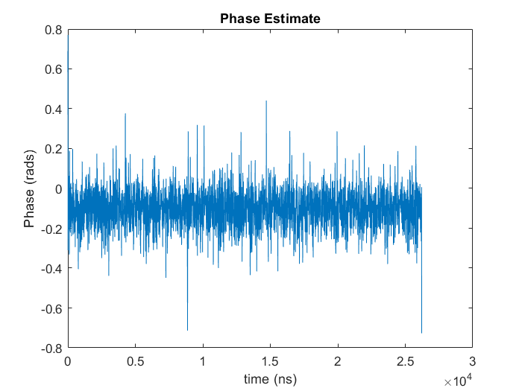
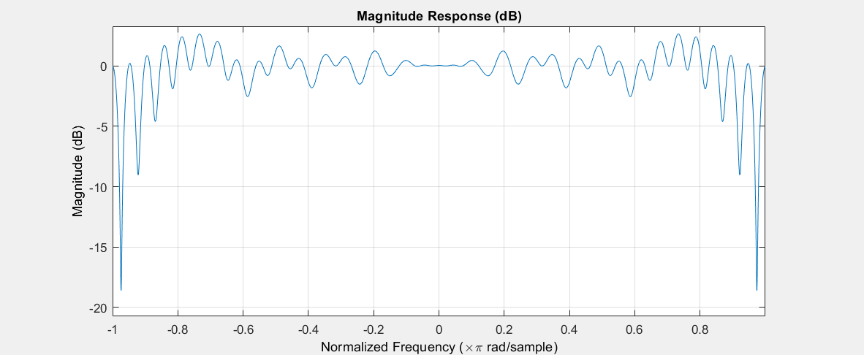
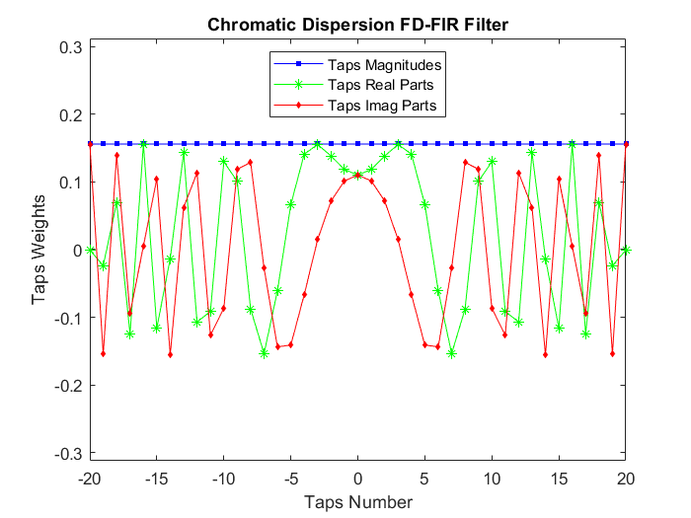
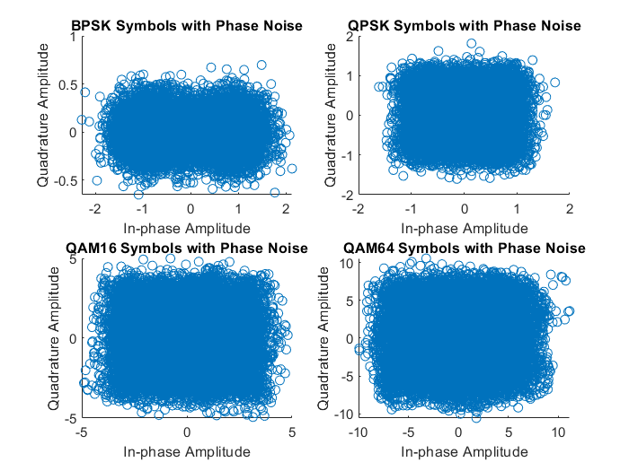
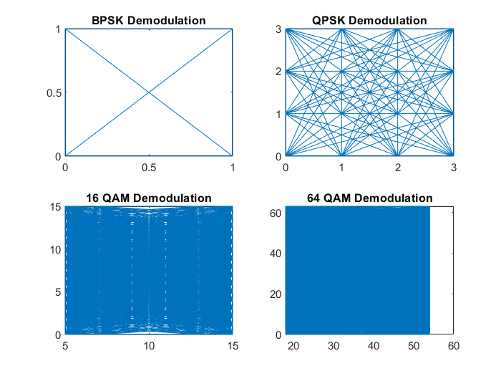

Slide 17
Probabilistic Shaping

